Slide 1
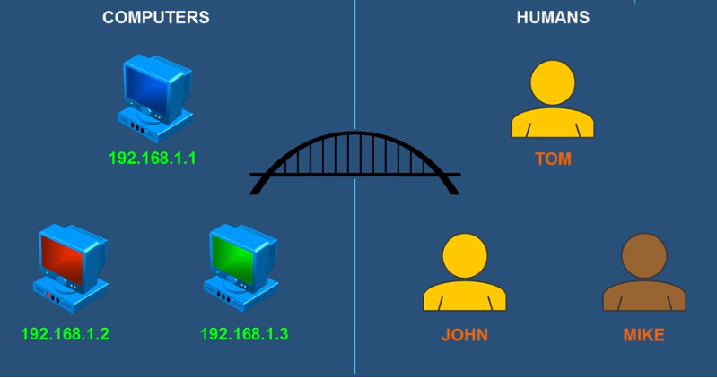
Communication
Names are easier to remember than numbers

Slide 2
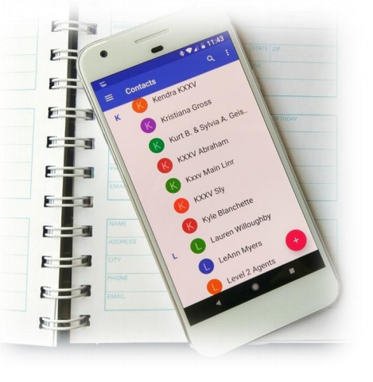
Name Resolution
Name resolution is a method of reconciling an IP address to a user friendly computer name.
There are several ways that the host machine can resolve a domain name.
The main ones are:
Hosts File Lookup (Local Resolution)
DNS Lookup (Global Resolution)
Generally a host will try multiple methods until it succeeds or runs out of
methods to try, and then it fails.
The order in which it tries this method is a host parameter that can be changed.
In Linux this is done in the /etc/nsswitch.conf file.

Slide 3
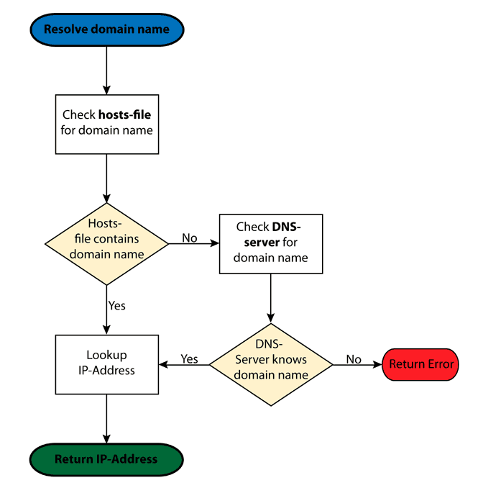
Name Resolution

Slide 4
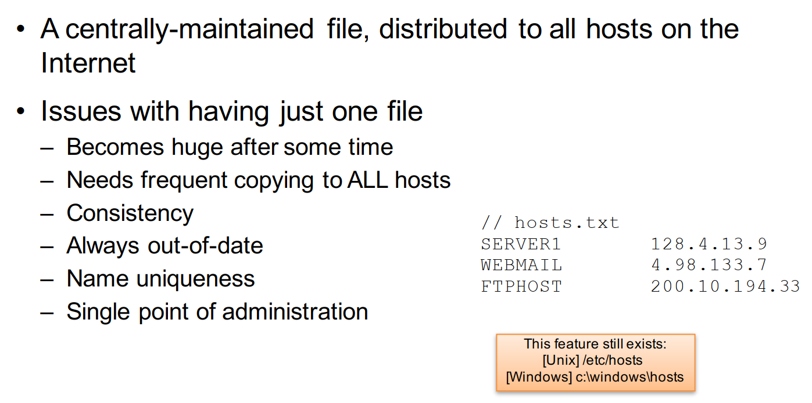
Name Resolution: hosts.txt

Slide 5
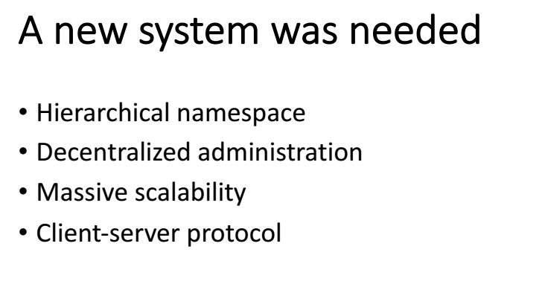

Slide 6
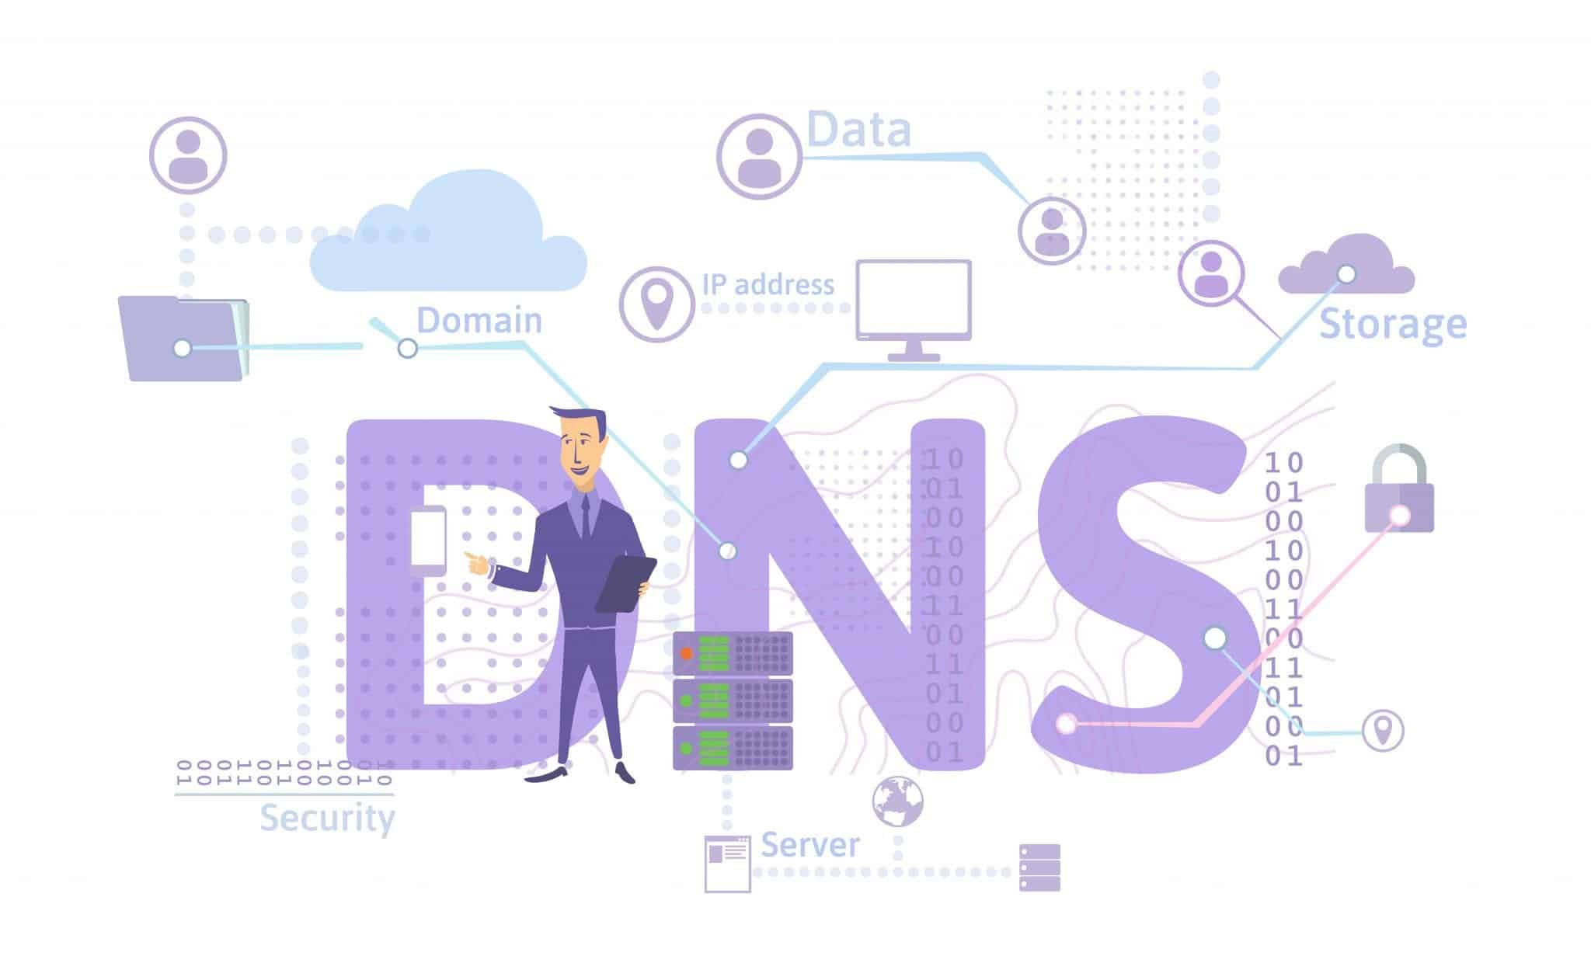

Slide 7
DNS
• A lookup mechanism for translating objects into other objects – Mapping names to numbers and vice versa

Slide 8
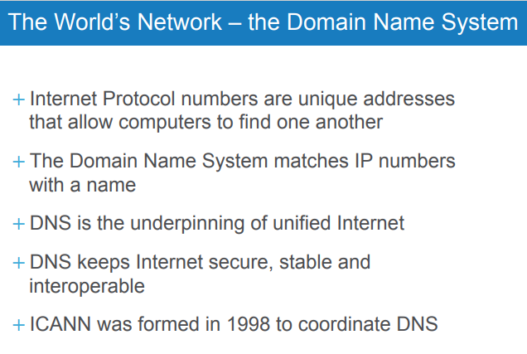

Slide 9
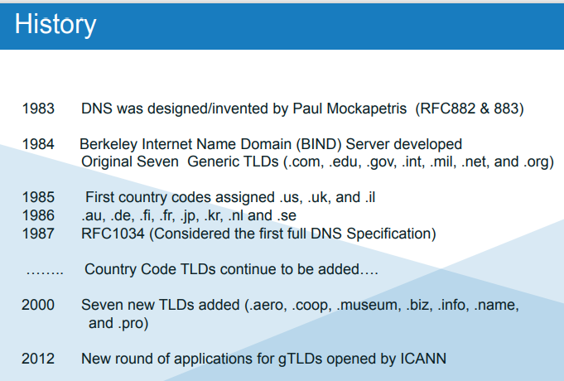

Slide 10
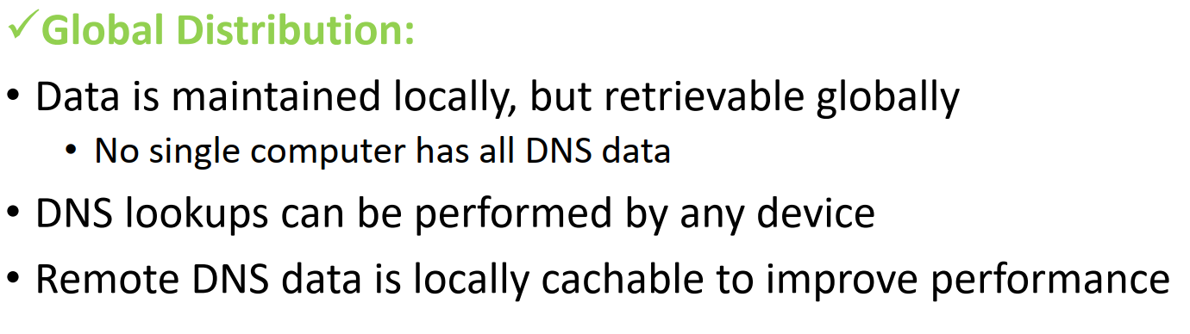
DNS Features

Slide 11
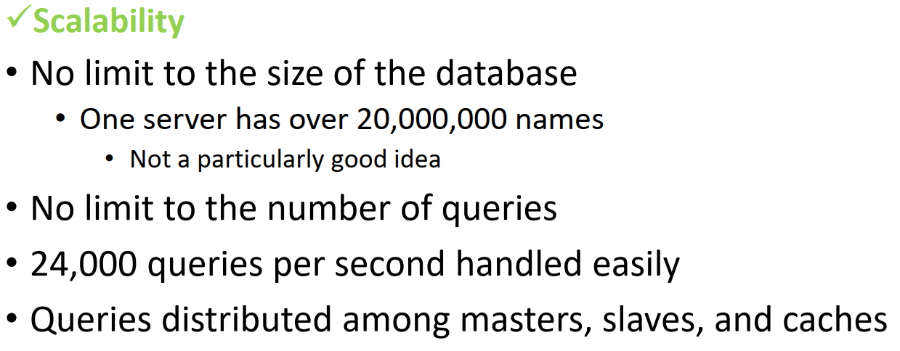
DNS Features

Slide 12
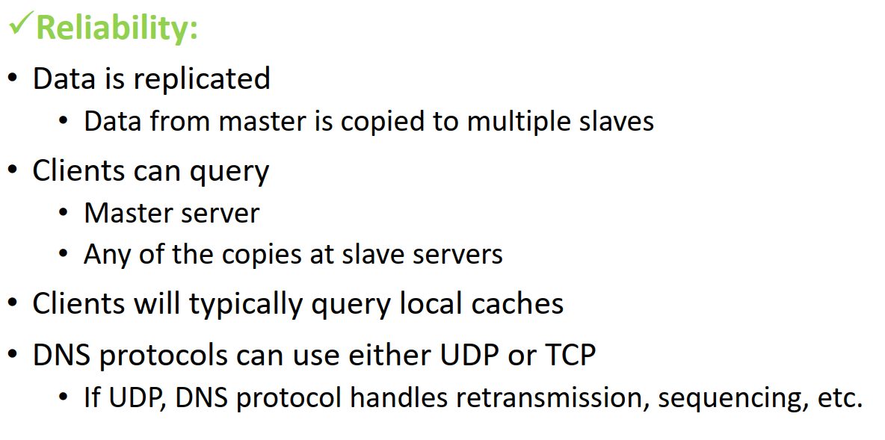
DNS Features

Slide 13
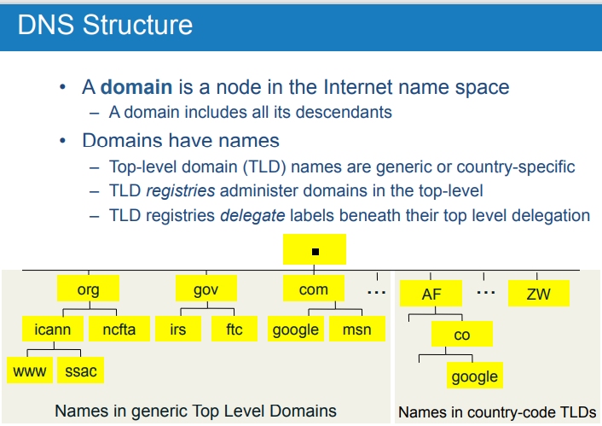

Slide 14
Database in Structured Format
Data is indexed by domain names
A domain name is a sequence of labels
Labels are separated by dots (“.”) and form a tree
Eg: www.classroom.edu

Slide 15
Hierarchical Database
Root (“.”) at top, domain names as leaves underneath
Administration is Shared
Authority is delegated, No single entity in charge.

Slide 16
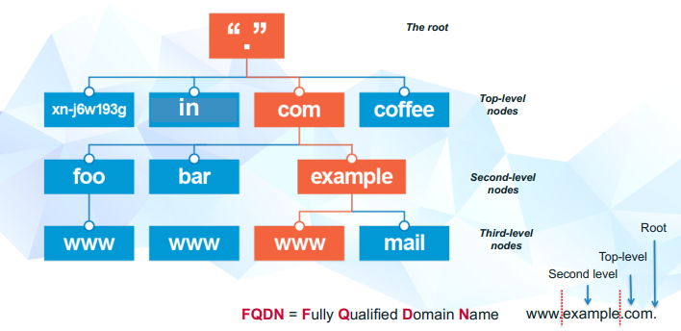
Hierarchical Database

Slide 17

All the Parts of a Domain Name

Slide 18
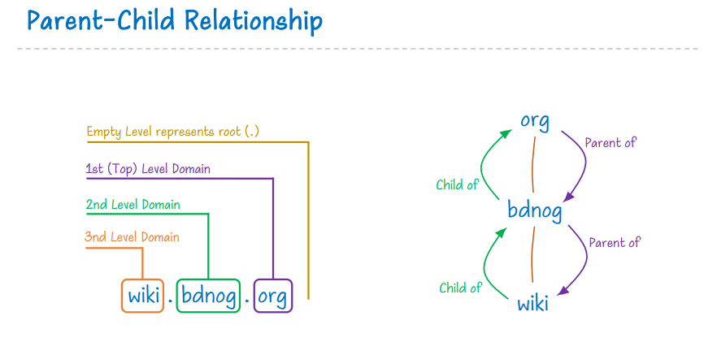

Slide 19
3rd Level-Subdomain
A subdomain is related to the main or root domain and is the portion to the left of your second-level domain.
If you own your own domain, such as myexample.org and decide to operate a blog on a subdomain, your domain would read as blog.myexample.org.
Sometimes you will see subdomains referred to as “third-level domains.”

Slide 20
Second-Level Domain or an SLD
A second-level domain (SLD) is the domain below the top-level domain and is located to the left of the extension you use. When you’re browsing for a domain name on Hover, you’re in the process of naming the SLD to pair with one of the many TLDs that Hover offers.
Your SLD is a great space for your brand name, product name, or your own name!

Slide 21
1st / Top-Level Domain or a TLD
TLD is a fancy term for your domain name’s extension, which are the letters to the right of your second-level domain.
An example of a domain name extension that you will recognize (unless you’re brand new to the Internet… where have you been?!) is .COM.
The .COM portion of your entire URL is your top-level domain, which is shortened to TLD for ease.
When we refer to TLDs, we are talking about the extension only.

Slide 22
Country-Code Top-Level Domain, or ccTLD
A country code top-level domain (ccTLD) refers to domain extensions that are specifically for regions or countries.
There are a few ccTLDs, such as .IO, .ME, and .TV, which Google treats as a gTLD in search since they have been shown to be commonly used outside of that geographic area for other purposes.
ccTLDs are the only top-level domains not governed by ICANN.
Any country can enter the market with their own TLD. A ccTLD can be easily spotted as it is always a two-letter domain extension, such as .CA, .US, or .FR.

Slide 23
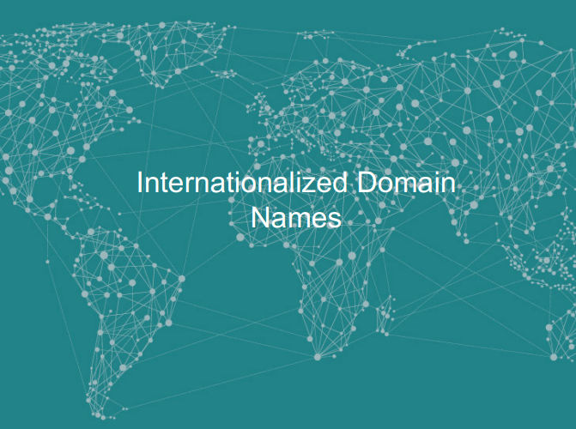

Slide 24
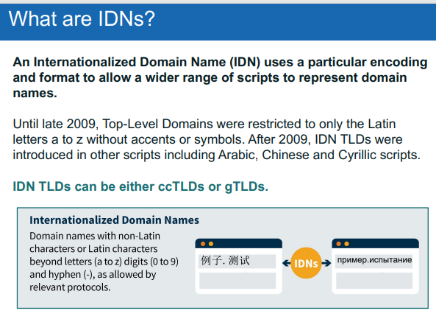

Slide 25
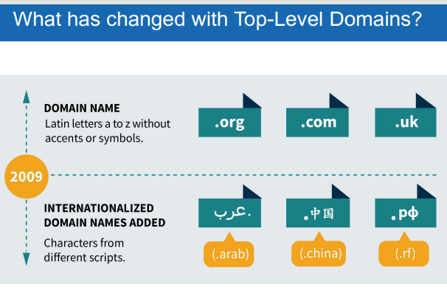

Slide 26
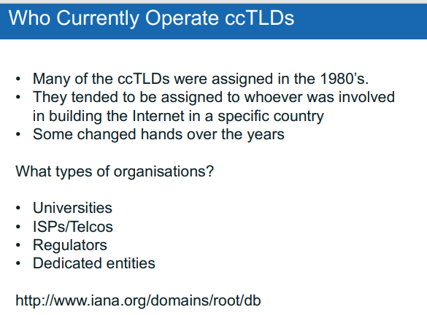

Slide 27
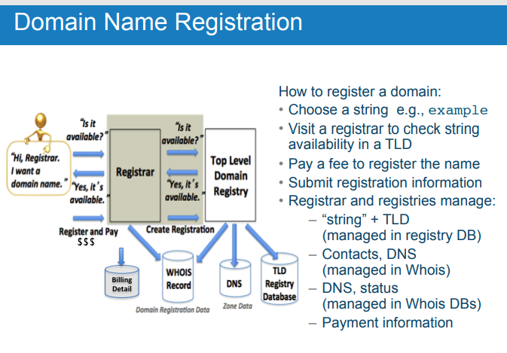

Slide 28
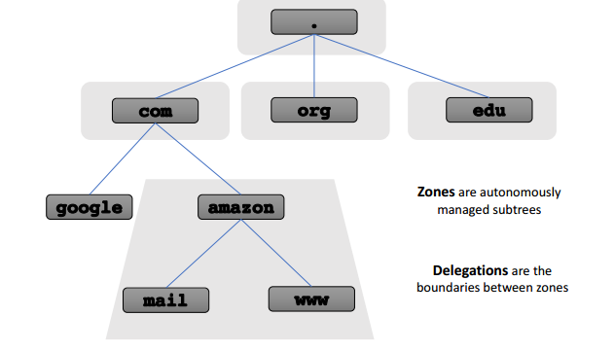

Slide 29
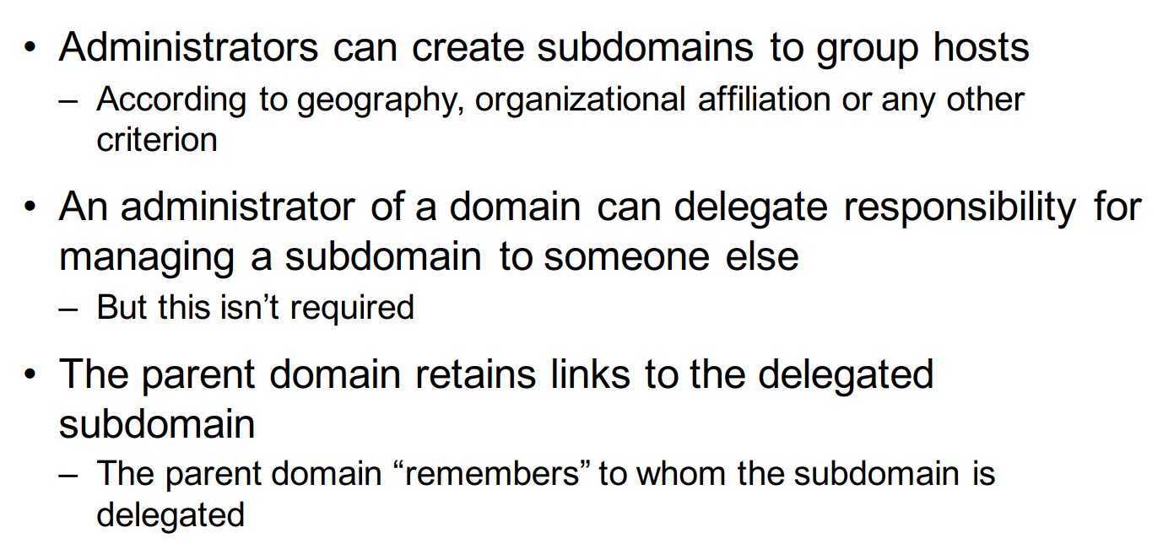
Delegation
DNS Delegation is the process of dividing up different parts of the DNS name space. This name space can be independently managed.

Slide 30
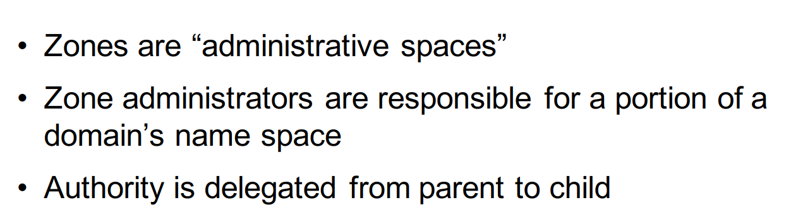
Zones and Delegations

Slide 31
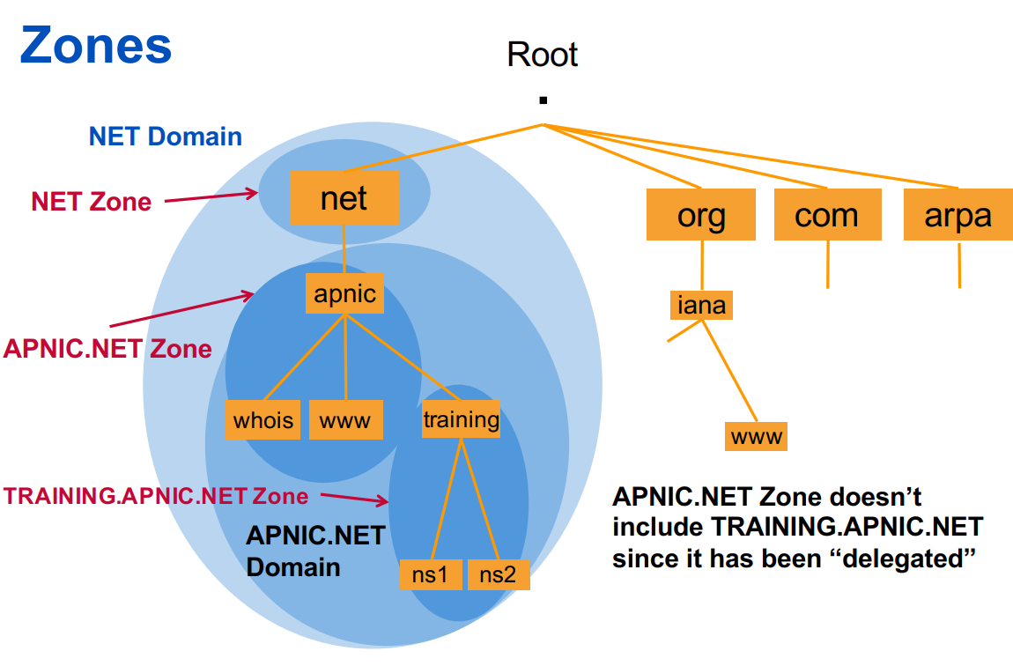

Slide 32
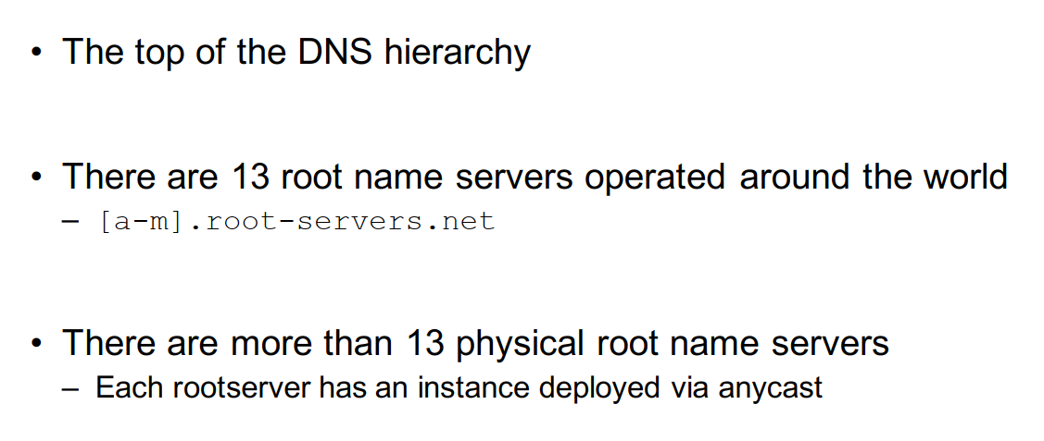
Root Servers

Slide 33
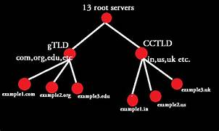

Slide 34
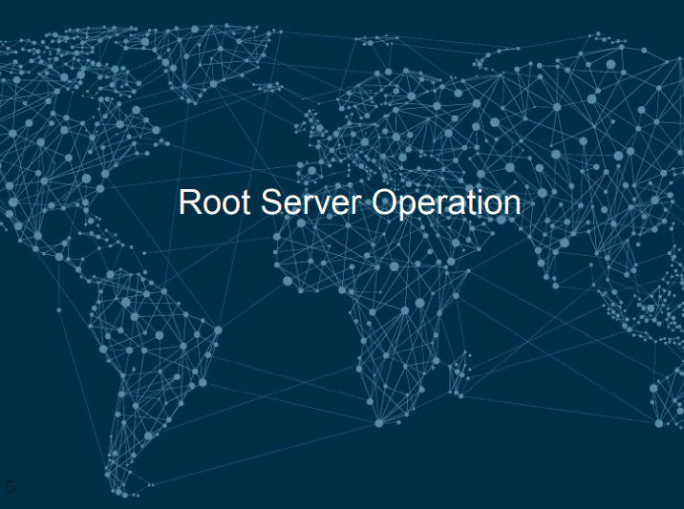

Slide 35
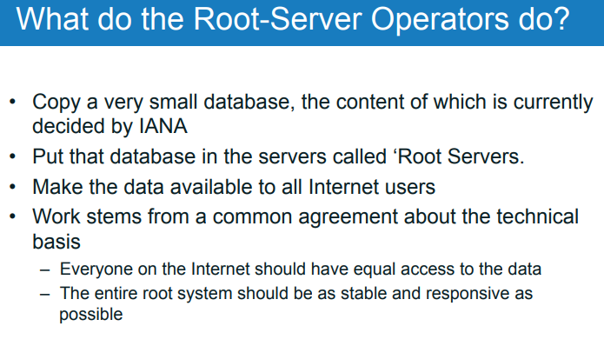

Slide 36
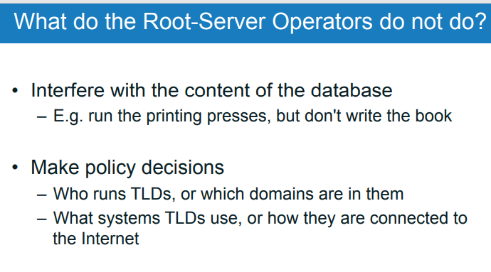

Slide 37
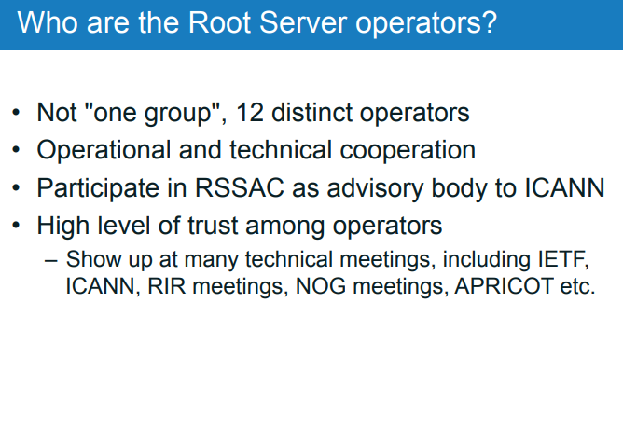

Slide 38
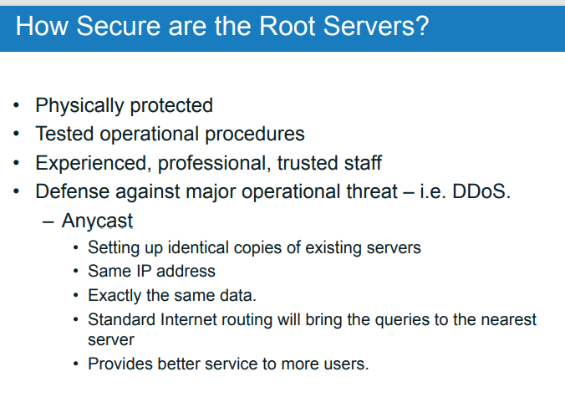

Slide 39
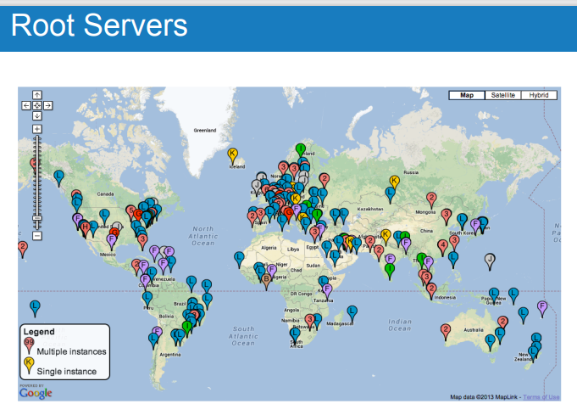

Slide 40
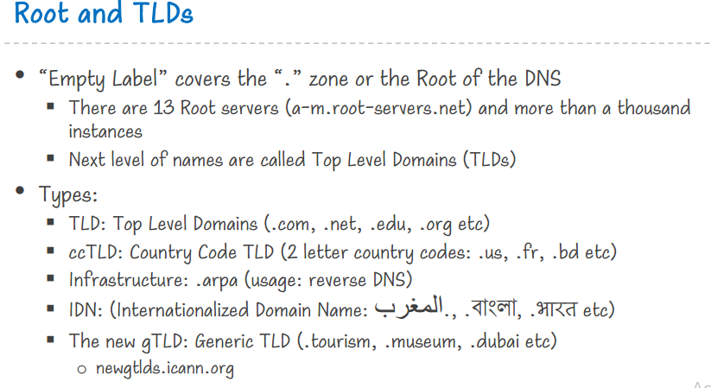

Slide 41
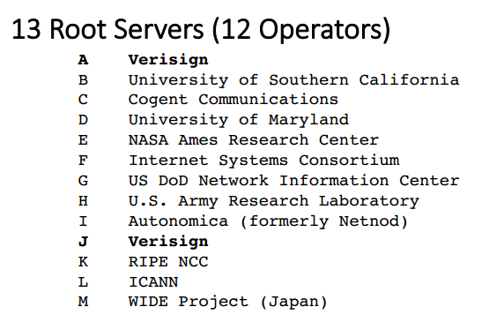

Slide 42
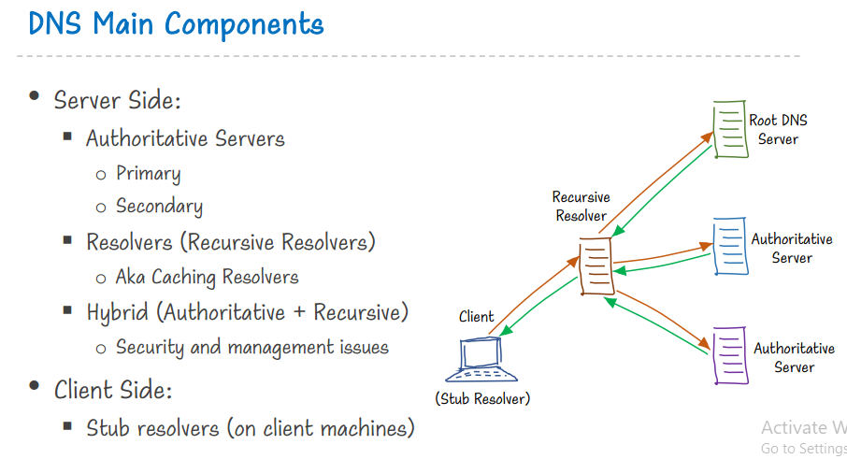

Slide 43
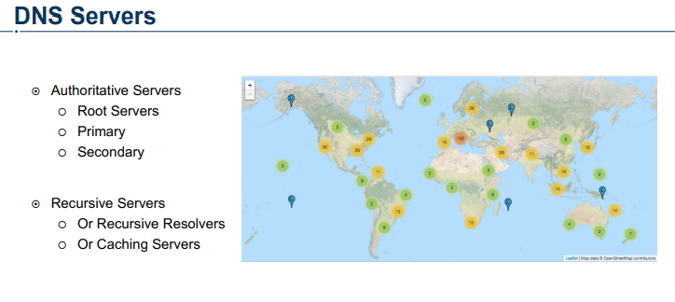

Slide 44
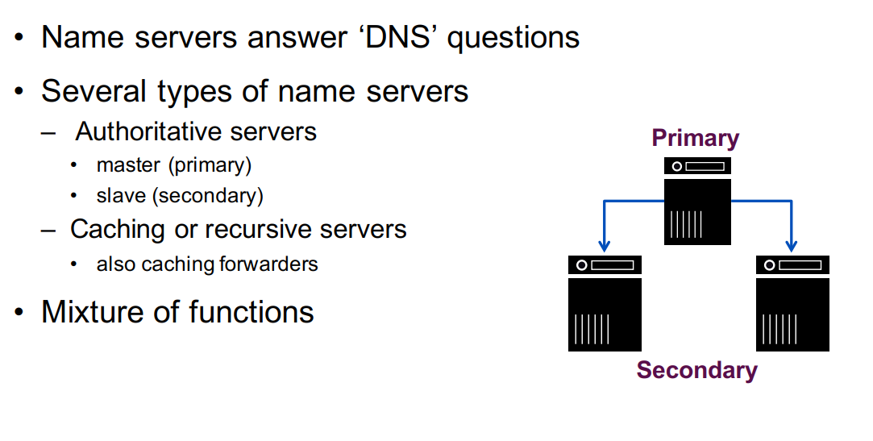
Name Server

Slide 45
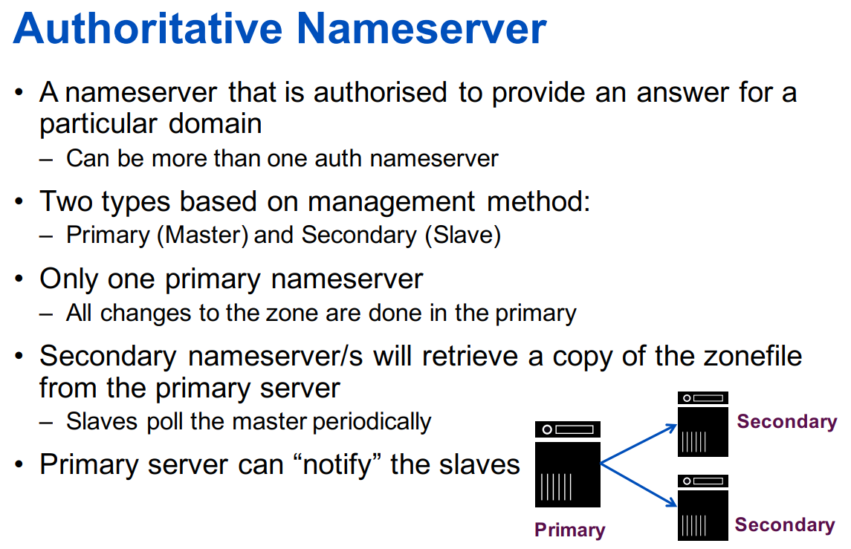

Slide 46
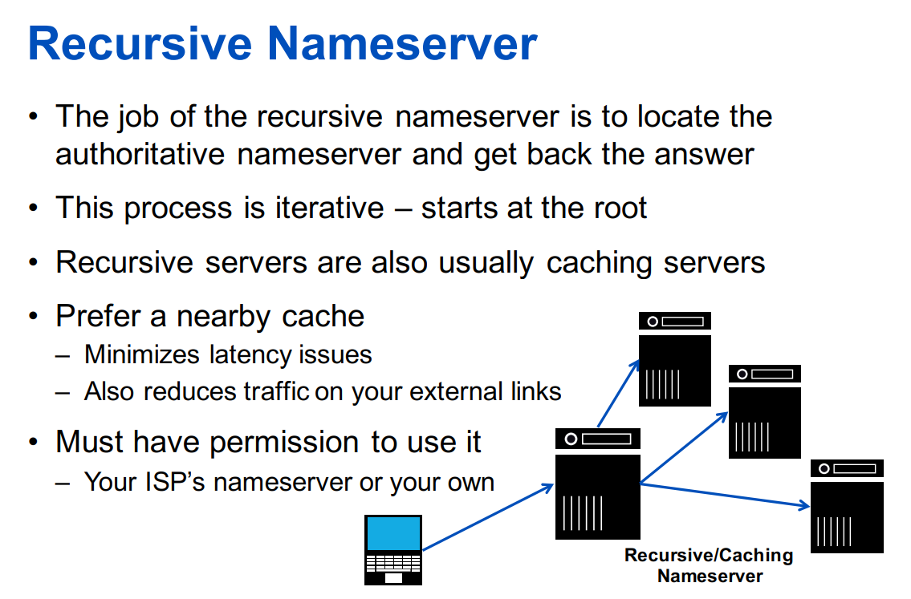

Slide 47
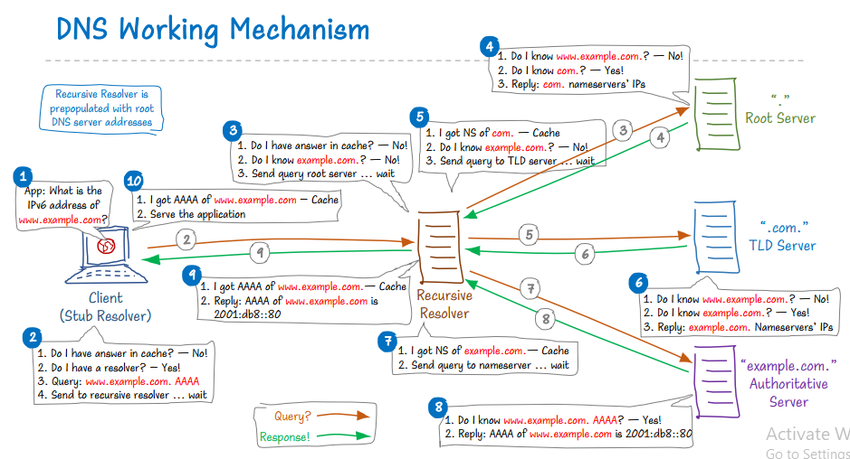

Slide 48
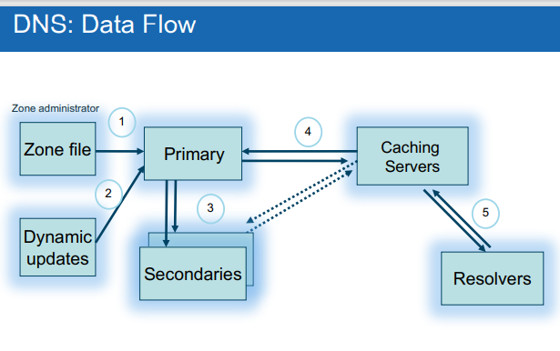

Slide 49
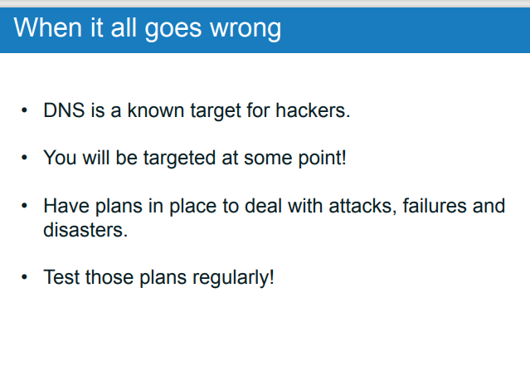

Slide 50
DNS Server Classification
In terms of Working Procedure:
Authoritative-Only DNS Server
Caching-Only or Caching DNS Server
Forwarding DNS Server
Hybrid DNS Server
In terms of Relation:
Primary or Master DNS Server
Secondary or Slave DNS Server
Public and Private DNS Server

Slide 51
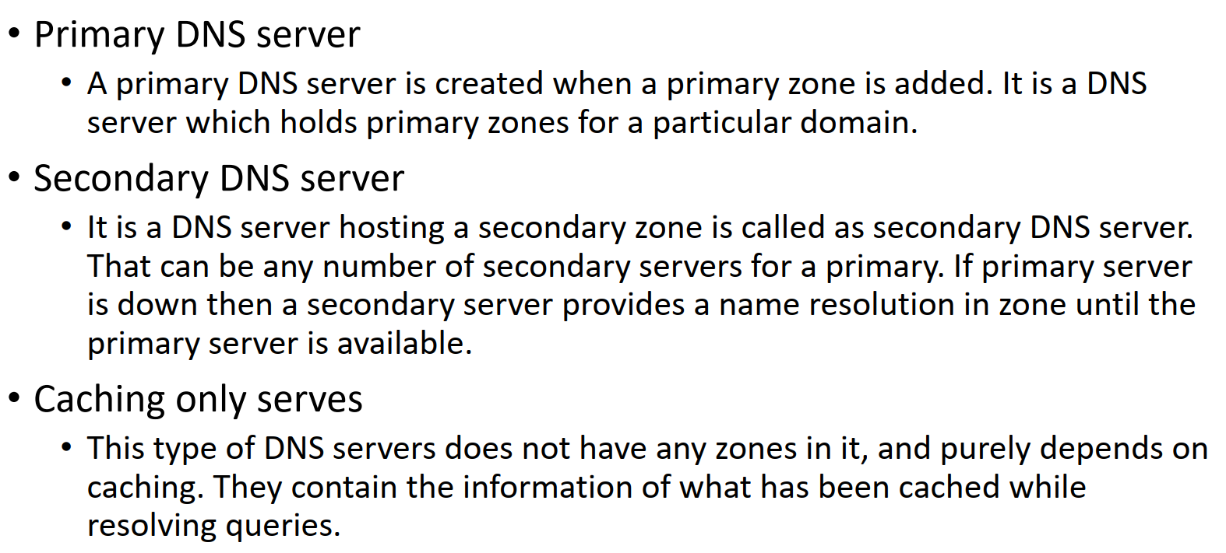
DNS Server Classification

Slide 52
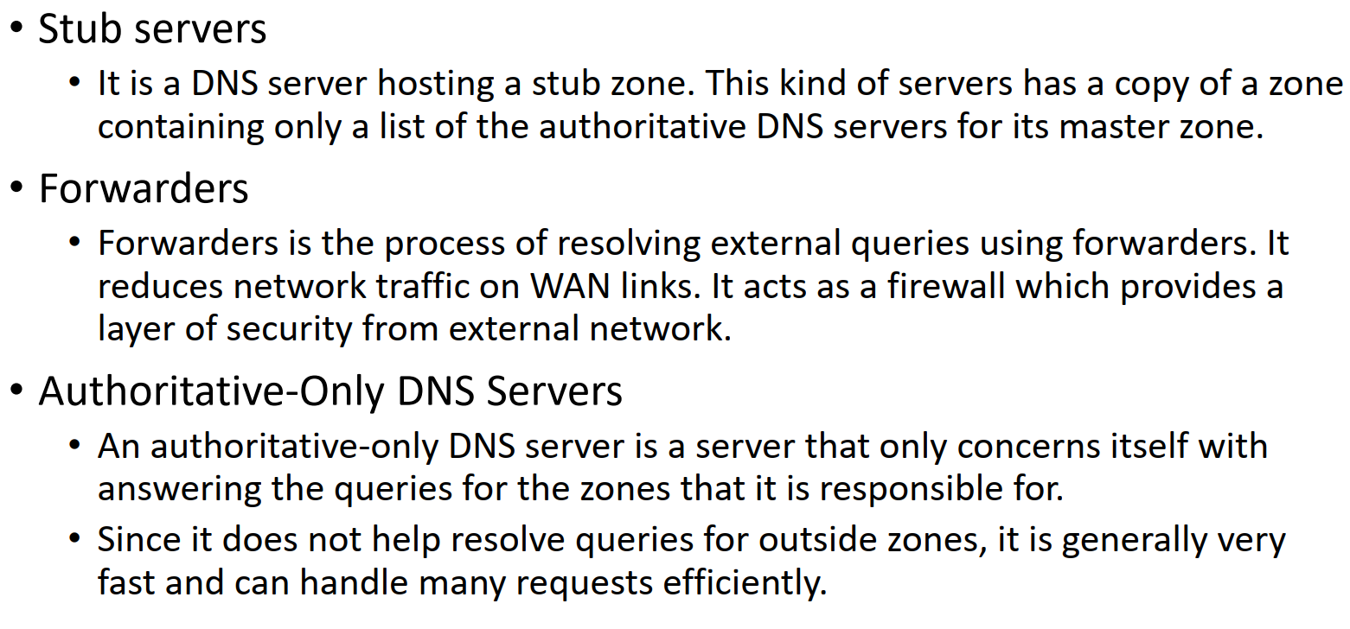
DNS Server Classification

Slide 53
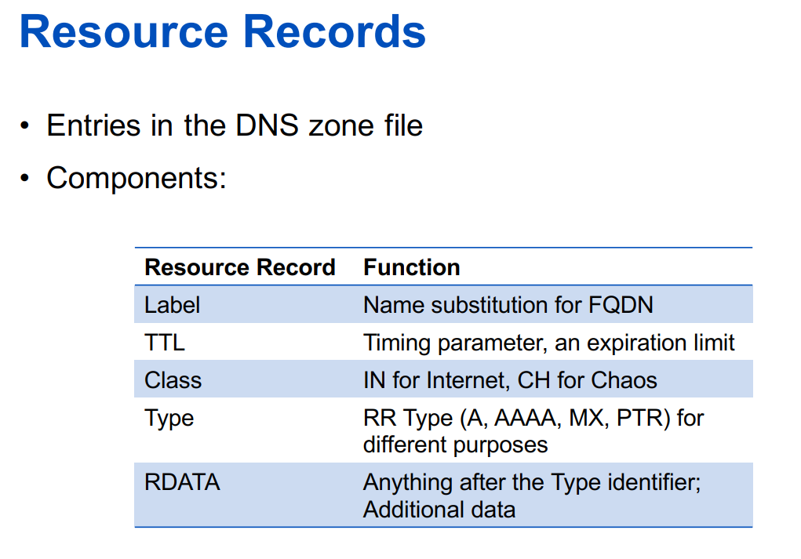

Slide 54
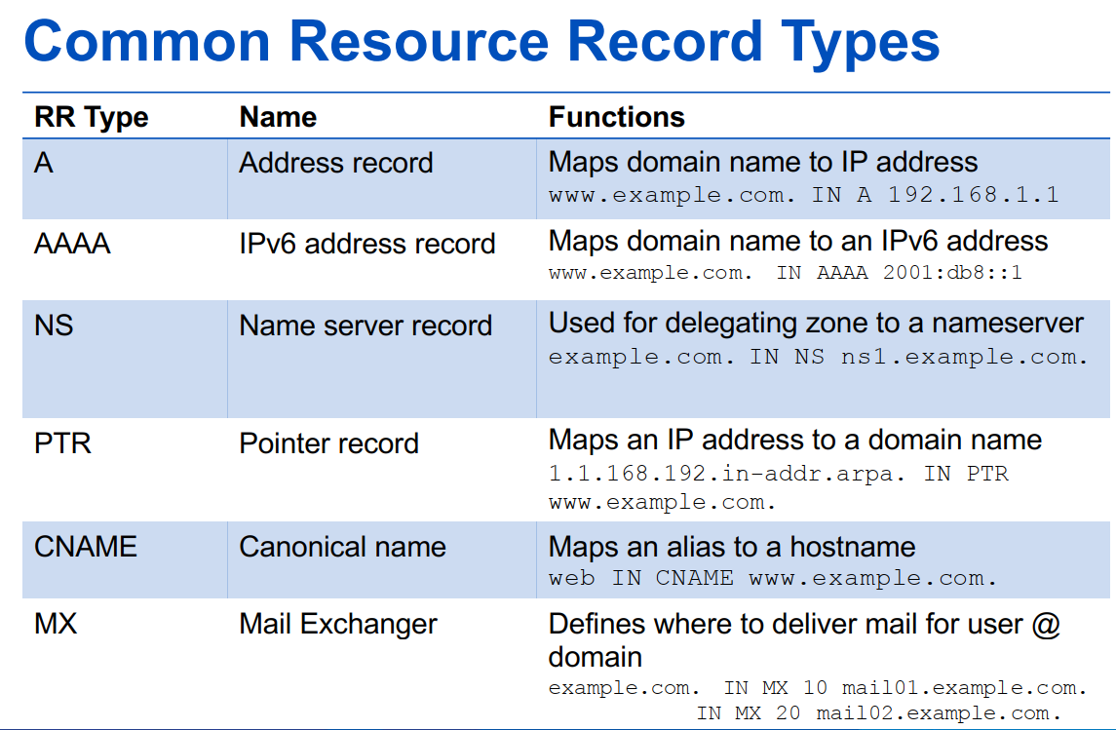

Slide 55
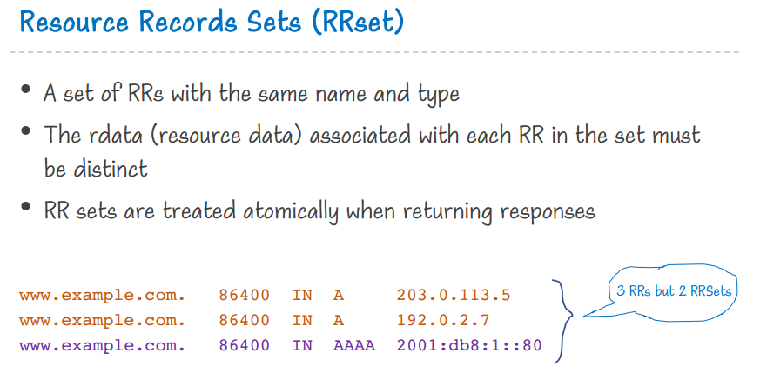

Slide 56
SOA Record
The DNS ‘start of authority’ (SOA) record stores important information about a domain or zone such as the email address of the administrator,
when the domain was last updated, and how long the server should wait between refreshes.
All DNS zones need an SOA record in order to conform to IETF standards. SOA records are also important for zone transfers.
Example of an SOA record:
name | example.com
record type | SOA
MNAME | ns.primaryserver.com
RNAME | admin.example.com
SERIAL | 1111111111
REFRESH | 86400
RETRY | 7200
EXPIRE | 4000000
TTL | 11200
The 'RNAME' value here represents the administrator's email address, which can be confusing because it is missing the ‘@’ sign, but in an SOA record admin.example.com is the equivalent of admin@example.com.

Slide 57
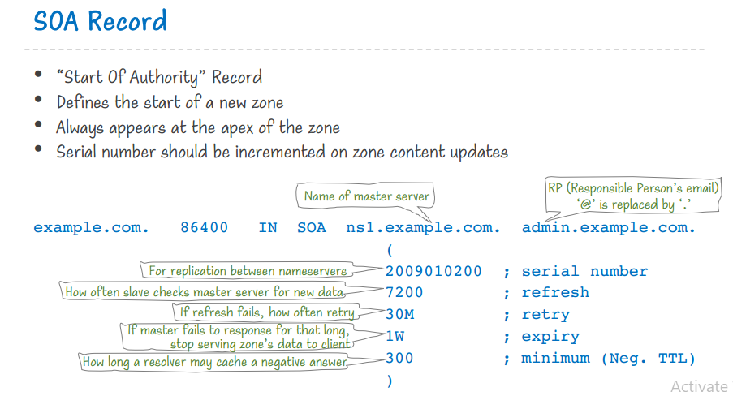

Slide 58
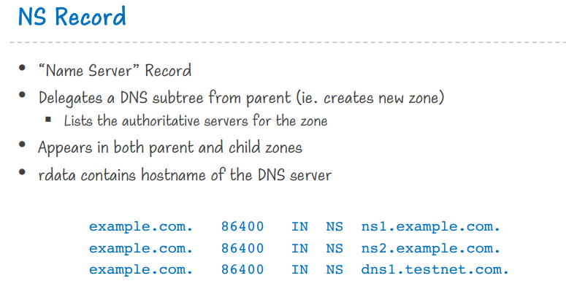

Slide 59
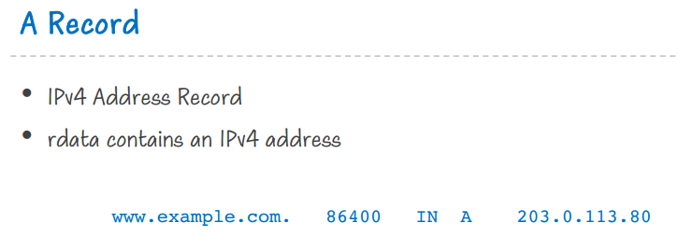

Slide 60
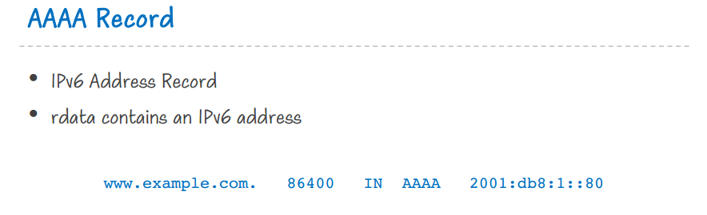

Slide 61


Slide 62


Slide 63


Slide 64
SRV Record
A Service record (SRV record) is a specification of data in the Domain Name System defining the location, i.e., the hostname and port number, of servers for specified services.
A SRV record has the form:
_service._proto.name. TTL class SRV priority weight port target.
service: the symbolic name of the desired service.
proto: the transport protocol of the desired service; this is usually either TCP or UDP.
name: the domain name for which this record is valid, ending in a dot.
TTL: standard DNS time to live field.
class: standard DNS class field (this is always IN).
SRV: Type of Record (this is always SRV).
priority: the priority of the target host, lower value means more preferred.
weight: A relative weight for records with the same priority, higher value means higher chance of getting picked.
port: the TCP or UDP port on which the service is to be found.
target: the canonical hostname of the machine providing the service, ending in a dot.
An example SRV record in textual form that might be found in a zone file might be the following:
_sip._tcp.example.com. 86400 IN SRV 0 5 5060 sipserver.example.com.
This points to a server named sipserver.example.com listening on TCP port 5060 for Session Initiation Protocol (SIP) protocol services. The priority given here is 0, and the weight is 5.

Slide 65


Slide 66


Slide 67


Slide 68


Slide 69
Glue Record
Glue records are A records or IP Addresses that are assigned or mapped to a Domain Name or a sub-domain.
Glue records become extremely important when the Nameservers for a domain name are the sub-domains of the domain name itself.
The Glue records can be seen under the “Additional Section” of a DNS Response.
Let’s take an example to understand how Glue Records work;
assume you have a domain name called “yourdomain.com” for which you are using the following set of Nameservers:
ns1. yourdomain.com
ns2. yourdomain.com
In the DNS Resolution process, the authoritative nameservers for yourdomain.com are ns1.yourdomain.com and ns2.yourdomain.com.
The DNS resolution for ns1.yourdomain.com would first require the resolution of yourdomain.com which in turn returns the authoritative nameservers as ns1 and ns2.yourdomain.
As you may have already noticed, this creates a circular dependency or in simple terms; a Loop and the resolution never succeeds.
Glue records help in breaking this dependency by providing the IP Addresses for ns1.yourdomain.com and ns2.yourdomain.com in the lookup process, this breaks the loop from getting created as we no longer need to resolve the nameservers for the IP Addresses – these addresses are already provided in the form of “Glue Records”.

Slide 70


Slide 71


In this example, I will show the difference between having Glue Records and not having them. If you do not provide the registry with Glue Records, other nameservers trying to look up the IP address of example.com would ask the .com (TLD) nameservers for a referral, and encountering the following issue:

Slide 72


Slide 73


Slide 74


Slide 75


